Slide 1



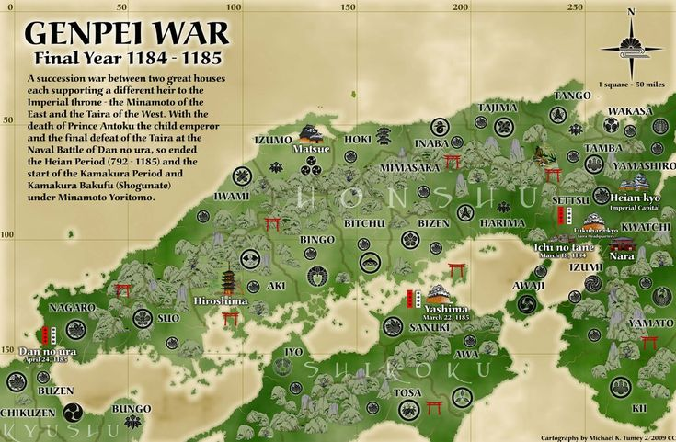

Genpei War
The Clash That Shaped the Samurai Era

Slide 2

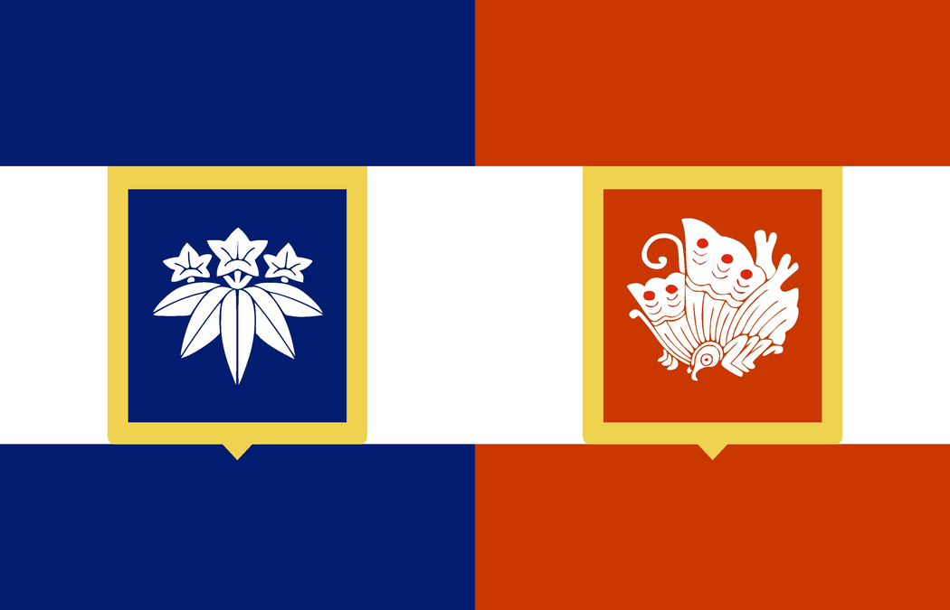
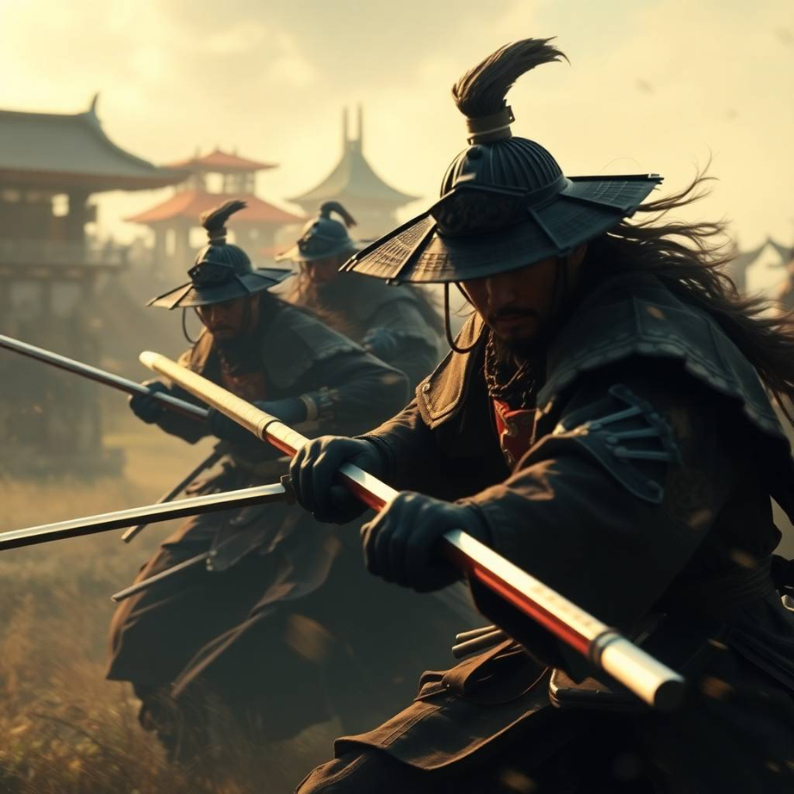
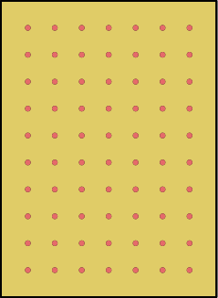


Introduction
The war began as a struggle for control over the imperial throne. In 1180, Emperor Go-Shirakawa’s son, Prince Mochihito, supported by the Minamoto clan, called for a rebellion against the ruling Taira clan, led by Taira no Kiyomori. Kiyomori had seized power and placed his infant grandson, Emperor Antoku, on the throne, effectively controlling Japan. This sparked resentment among rival samurai clans and court factions, leading to an all-out war between the Taira and Minamoto.

Slide 3
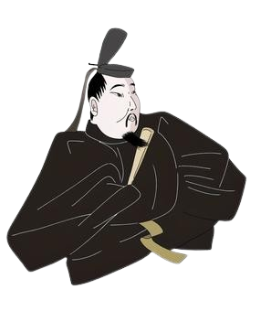
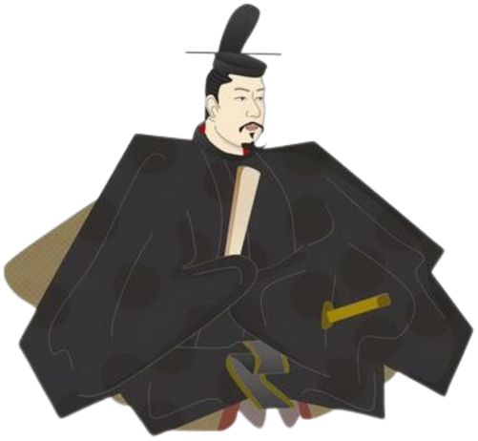
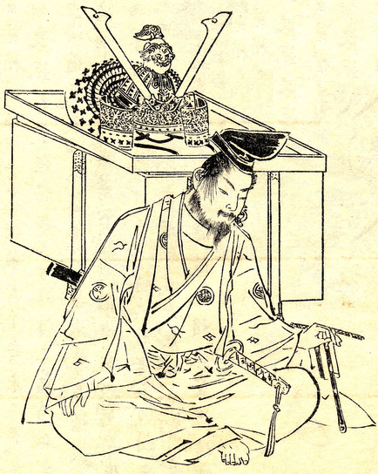
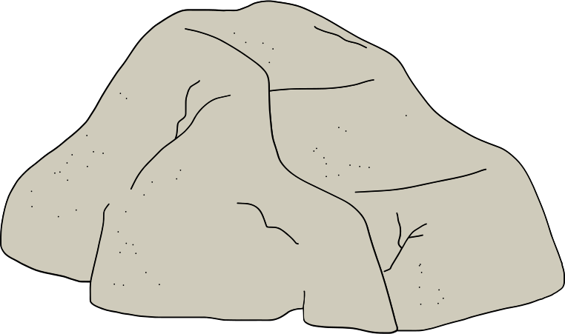
Main Figures of the War
MINAMOTO NO YORITOMO
MINAMOTO NO YOSHITSUNE
TAIRA NO MUNEMORI
(1147–1199)
(1159–1189)
(1147–1185)

Slide 4

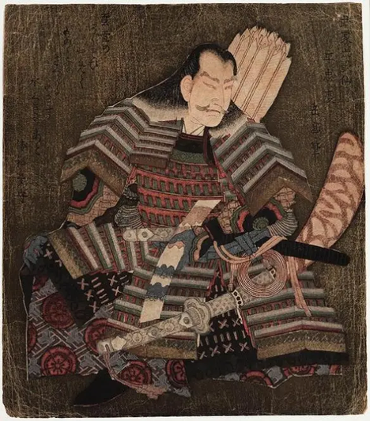
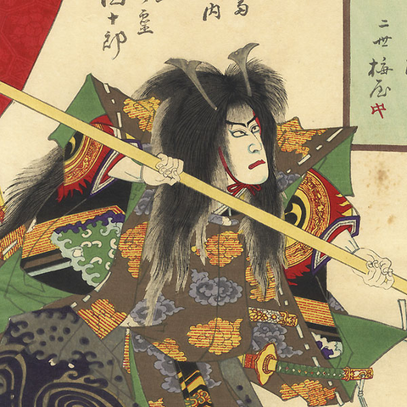
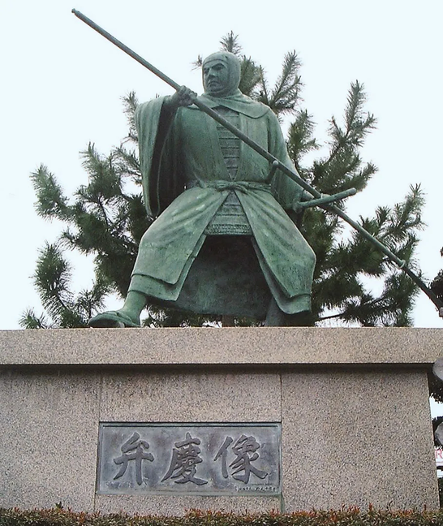
Main Figures of the War
TAIRA NO KIYOMORI
TAIRA NO TOMOMORI
BENKEI
(1118–1181)
(1152–1185)
(?-1189)

Slide 5
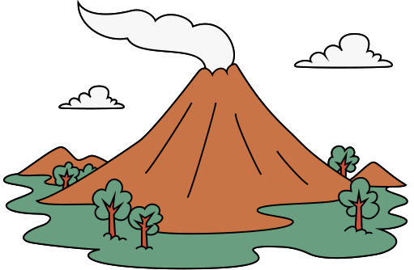

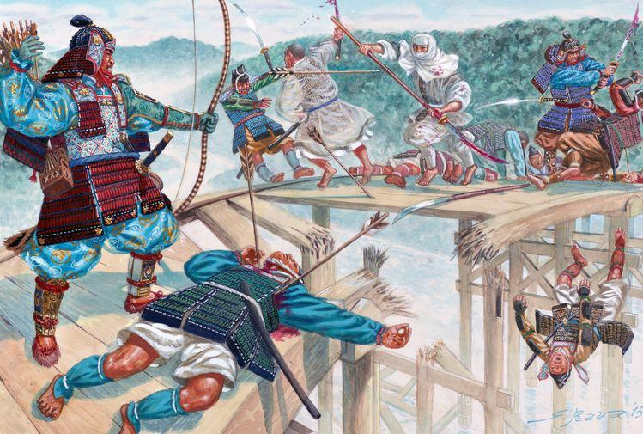

1156
1160
(June 1180)
1181
Heiji
Rebellion
Death of Kiyomori
Hōgen
Rebelion
Battle of Uji (1180)
Prince Mochihito fled to Byoudou-in Temple
In a desperate effort to slow the Taira advance, the defenders smashed the bridge’s planks, making it nearly impossible to cross.
First recorded instance of samurai seppuku as a way to preserve honor.
Set the tone for the Minamoto-Taira conflict—ruthless, tactical, and filled with legendary heroism

Slide 6
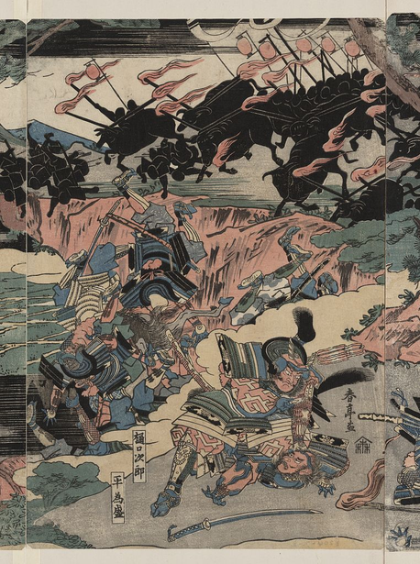
(Yoshinaka was killed)
Second Battle of Uji
Battle of Awazu
Battle of Ichi-no-Tani
(
Yoshitsune’s brilliant cliff charge made Taira retreat to Yashima
)
June 1183
1184
February 1184
March 1184
Battle of Kurikara (1183)
First recorded use of psychological warfare in samurai battles – Yoshinaka’s oxen trick was both terrifying and devastating.
One of the deadliest samurai ambushes in history – The 3 phase ambush – An estimated 25,000 Taira soldiers were wiped out in a single night.
The beginning of Minamoto dominance – After this, the Taira never fully recovered from their loss.
Kurikara became a legendary tactic – Future samurai warlords studied Yoshinaka’s brilliant ambush strategy for centuries.

Slide 7

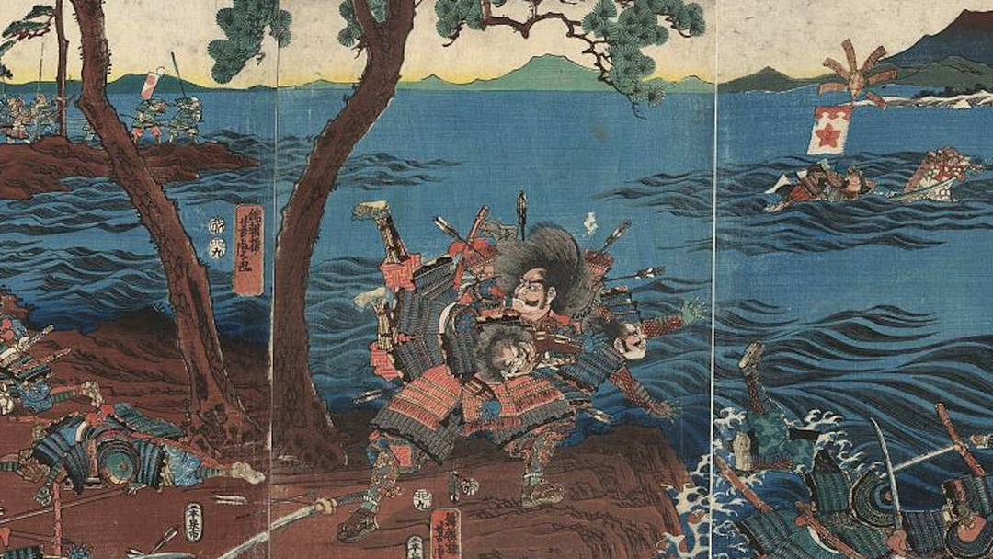
Yoshitsune make Taira leave their strong hold
Battle of Yashima
(April 1185)
(March 1185)
Battle of Dan-no-ura (1185)
The Taira had nowhere left to run and made their last stand at Dan-no-ura, a strait in the Inland Sea.
At first, the Taira were winning because their sailors were more experienced at sea. But then, a Taira general named Taguchi Shigeyoshi betrayed them and revealed their battle plans to Yoshitsune!
Taira no Tomomori and many Taira warriors committed suicide by jumping into the sea.
Emperor Antoku’s grandmother took him in her arms and leaped into the ocean, drowning the young emperor to prevent his capture.

Slide 8
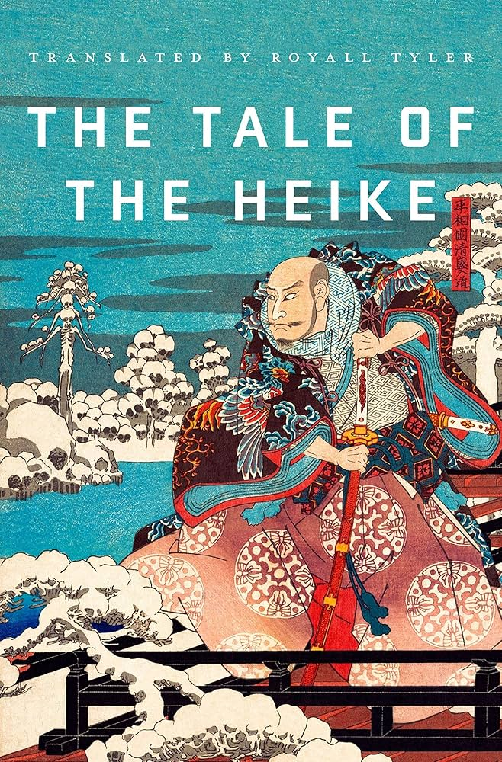

The Tale of the Heike
It portrays the war’s heroes, including Taira no Kiyomori, Minamoto no Yoshitsune, and Minamoto no Yoritomo, while emphasizing the Buddhist concept of mujō (impermanence), showing how power and glory are fleeting. The work serves as both a historical account and a moral lesson on the transient nature of life.

